Slide 1


Presentation Title
Name Job Title Employer

Slide 2
Template Usage (Delete after acknowledgment)
Presentations at tcworld China conferences are to be fundamentally structured without advertising or product recommendations. For purely product presentations, please contact tcworld China Team.
Headings and subheadings are adjusted as appropriate, the template is for reference only.
If you would like to apply your own corporate design in the main body of your presentation, please place your slides between the front and back tcworld slides provided.
Please name your presentation slides following the example below: tcworld_China_2022_Speaker_Name_Presentation_Title_Language, e.g. tcworld_China_2019_Cruce_Saunders_From_Manual_To_Autonomous_The_Future_Of_The_Content_Supply_Chain_EN

Slide 3
Agenda
Heading 1
Heading 2
Heading 3
……
Q&A
Survey

Slide 4
Heading 1
Subheading 1.1
Subheading 1.2
Subheading 1.3

Slide 5
Subheading 1.1

Slide 6
Subheading 1.2

Slide 7
Subheading 1.3

Slide 8
Heading 2
Subheading 2.1
Subheading 2.2
Subheading 2.3

Slide 9
Subheading 2.1

Slide 10
Subheading 2.2

Slide 11
Subheading 2.3

Slide 12
Heading 3
小标题3.1
小标题3.2

Slide 13
Subheading 3.1

Slide 14
Subheading 3.2

Slide 15
Subheading 4
小标题4.1
小标题4.2

Slide 16
Subheading 4.1

Slide 17
Subheading 4.2

Slide 18
Q&A
Want to talk more? You can continue to interact with me in the next half hour in the tcworld China 2022 interactive space.

Slide 19
Survey
Thank you all for listening!
Please scan the QR code below and tell us your feedback on this presentation.
QR code to be generated soon

Slide 20

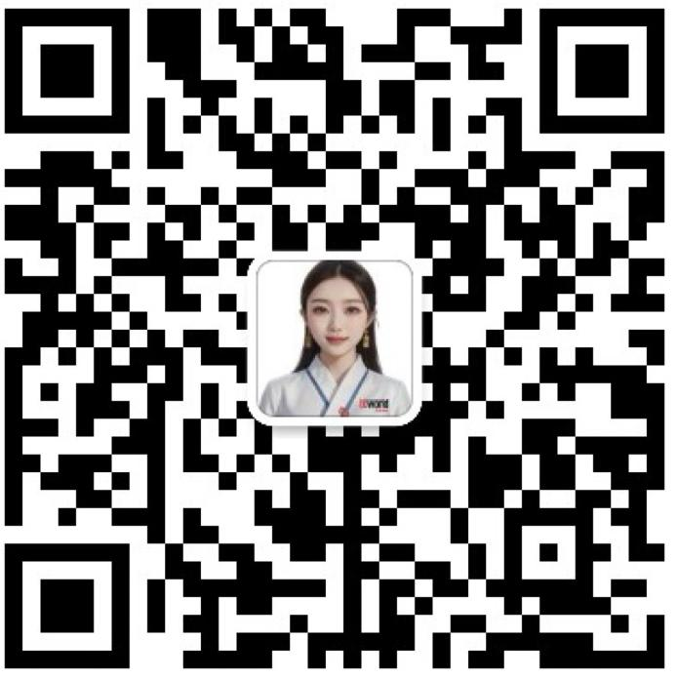

Email：
contact@tcworld-china.cn
Customer service (Wechat ID):
tcworldchina
LinkedIn:
tcworld-china
WeChat Official Account：

